Slide 1
Capstone Project – 1
EDA – 1 HOTEL BOOKING ANALYSIS
TEAM MEMBERS PIYUSH RATRA

Slide 2
HOTEL BOOKING ANALYSIS
INTRODUCTION – WHAT I DO IN MY CAPSTONE PROJECT
CAPSTONE PROJECT – 1
THIS IS A HOTEL BOOKING ANALYSIS CAPSTONE PROJECT
MADE BYPIYUSH RATRA. IN THIS CAPSTONE PROJECT I AM
DONE SOMEANALYSIS RELATED TO THIS HOTEL BOOKING
ANALYSIS. IN THIS PROJECT FIRST OF ALL, I ATTACH THE CSV
FILE , THEN I WERE CLEAN THE DATA , AFTER THAT I WAS
DONE SOME EXPLORATORY ANALYSIS VISULIZATION. AT THE
LAST I WAS DONE QUESTIONS ANSWERS AND SOME
INFERENCES AND CONCLUSION.
THIS IS WHAT I DO IN MY CAPSTONE PROJECT
THANKYOU

Slide 3
CHALLENGES :
TO FIND THAT COLUMNS WHICH HAVE NULL VALUES OR MISSING VALUES
REMOVE THAT COLUMNS WHICH ARE REQUIRED IN THESE ANALYSIS.
TO CREATING THE NEW DATASETS OF BOTH THE OTEL IN THE ANALYSIS.

Slide 4
DATASETS :
We are given a hotel bookings dataset. This dataset contains booking information for a city hotel and a resort hotel. It contains the following features.
- hotel: Name of hotel ( City or Resort)
- is_canceled: Whether the booking is canceled or not (0 for no canceled and 1 for canceled)
- lead_time: time (in days) between booking transaction and actual arrival.
- arrival_date_year: Year of arrival
- arrival_date_month: month of arrival
- arrival_date_week_number: week number of arrival date.
- arrival_date_day_of_month: Day of month of arrival date
- stays_in_weekend_nights: No. of weekend nights spent in a hotel
- stays_in_week_nights: No. of weeknights spent in a hotel
- adults: No. of adults in single booking record.
- children: No. of children in single booking record.
- babies: No. of babies in single booking record.
- meal: Type of meal chosen
- country: Country of origin of customers (as mentioned by them)
- market_segment: What segment via booking was made and for what purpose.
- distribution_channel: Via which medium booking was made.
- is_repeated_guest: Whether the customer has made any booking before(0 for No and 1 for
Yes)
- previous_cancellations: No. of previous canceled bookings.
- previous_bookings_not_canceled: No. of previous non-canceled bookings.
- reserved_room_type: Room type reserved by a customer.
- assigned_room_type: Room type assigned to the customer.
- booking_changes: No. of booking changes done by customers
- deposit_type: Type of deposit at the time of making a booking (No deposit/ Refundable/ No refund)
- agent: Id of agent for booking
- company: Id of the company making a booking
- days_in_waiting_list: No. of days on waiting list.
- customer_type: Type of customer(Transient, Group, etc.)
- adr: Average Daily rate.
- required_car_parking_spaces: No. of car parking asked in booking
- total_of_special_requests: total no. of special request.
- reservation_status: Whether a customer has checked out or canceled,or not showed
- reservation_status_date: Date of making reservation status.

Slide 5
Mainly performed using Matplotlib and Seaborn library and the following graph and plots had been used:
Bar Plot.
Scatter Plot..
Line Plot.
Box Plot

Slide 6
DATA SUMMARY
DATA CLEANING : IN DATA CLEANING FIRST WE CLEAN THE DUPLICATE ROWS THEN HANDLING SOME NULL VALUES THE CHILDREAN NULL VALUES REPLACE WITH ‘0’, THE COUNTRY NULL VALUES REPLACE WITH ‘XYZ’. AFTER THIS I REMOVE THE COLUMNS WHICH ARE NOT REQUIRED IN THESE ANALYSIS THEN CREATE A NEW VARIABLE CALLED ‘SELECTED VALUES’ TO STORE THESE NEW COLUMNS. THEN I DROP THE BABIES COLUMN ALSO BECAUSE THE BABIES ARE NOT ACCOUNTED INTO MONETARY ASPECTS. AFTER THIS ALL I CREATED A DIFFERENT DATASET OF BOTH HOTEL TYPES CALLED ‘RESORTHOTEL_DF’ FOR RESORT HOTELS AND ‘CITYHOTEL_DF’ FOR CITY HOTEL.
THIS IS ALL WHAT I DO DATA CLEANING.

Slide 7
DATA SUMMARY
EXPLORATORY ANALYSIS VISULIZATION : IN THIS EXPLORATORY ANALYSIS VISULIZATION I DO A LOTS OF ANALYSIS THERE, FIRSTLY I HAD DONE ALL THE IMPORTED STUFF THERE
(SEABORN,MATPLOTLIB,MATPLOT.PYPLOT),THEN I VISULIZE ALL THE HOTEL THAT HAVE YEARLY WISE BOOKINGS (WITH TH HELP OF BARCHART), AFTER THIS I VISULIZE FROM WHERE THE MOST GUESTS ARE COMING (WITH THE HELP OF BARCHART), THEN I VISULIZE THE BOOKING CANCELLATIONS (TO KNOW THAT WHICH HOTEL HAS MORE CANCELLATIONS), THEN I VISULIZE THE MONTHLY BOOKINGS AND MONTHLY CANCELLATIONS, IN THIS I ALSO VISULIZE THE MARKET SEGMENT WISE BOOKINGS, AT THE LAST I VISULIZE THE PLOTTING MONTHLY CACELLATIONS AND CUSTOMER TYPE.
THIS IS ALL WHAT I DO IN EXPLORATORY ANALYSIS VISULIZATION.

Slide 8
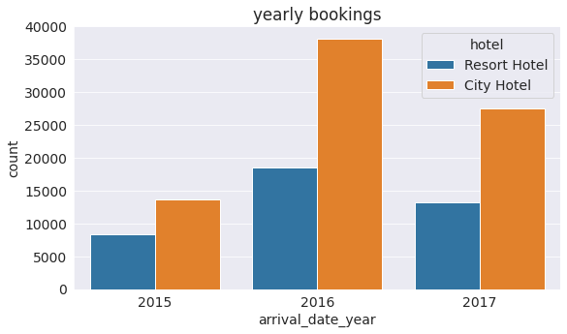
EDA (HOTEL BOOKING ANALYSIS) :
1. Visulizing Hotel Wise Yearly Bookings :

Slide 9
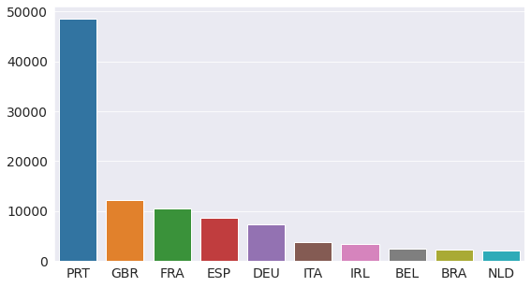
EDA (HOTEL BOOKING ANALYSIS) :
2. From Where The Most Guests Are Coming ?

Slide 10
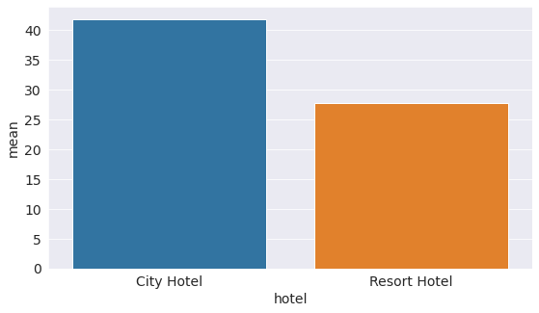
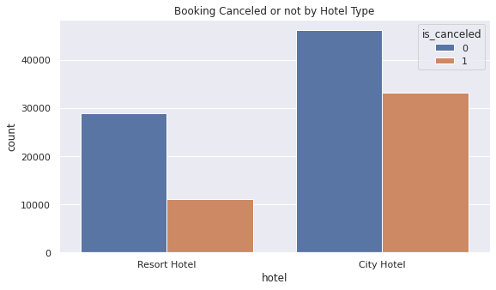
EDA (HOTEL BOOKING ANALYSIS) :
3. Visulizing Proportion of Booking Cancellations Vis a Vis Bookings.

Slide 11
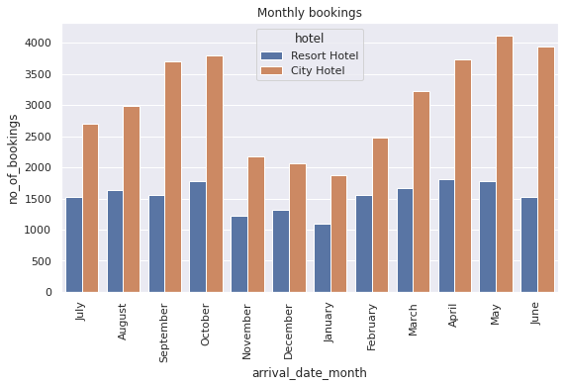
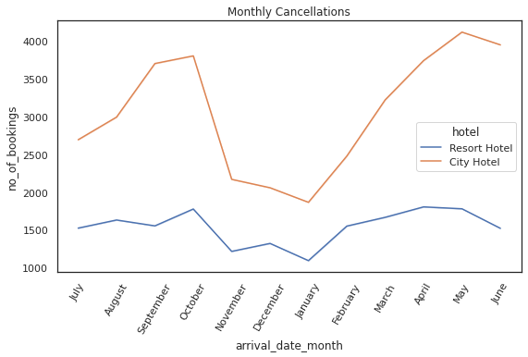
EDA (HOTEL BOOKING ANALYSIS) :
4. Visualizing Montly Bookings And Montly Cancellations.

Slide 12
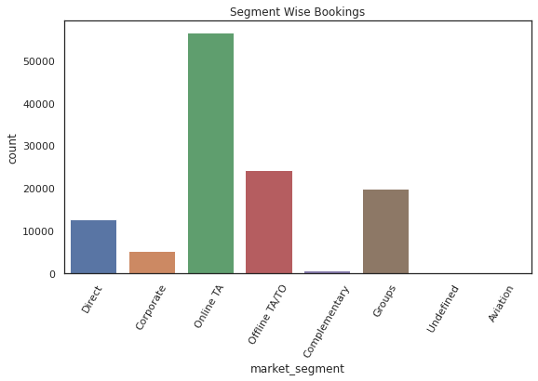
EDA (HOTEL BOOKING ANALYSIS) :
5. Market Segment Wise Bookings.

Slide 13
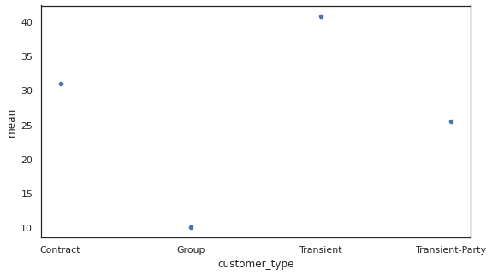
EDA (HOTEL BOOKING ANALYSIS) :
6. Plotting Monthly Cancellations And Customer Type.

Slide 14
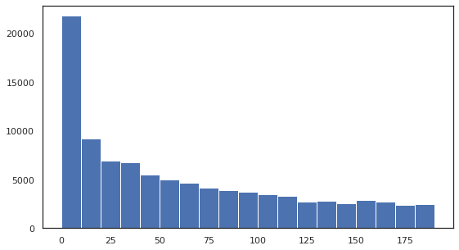
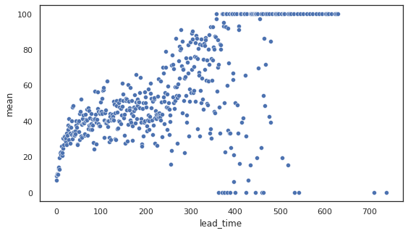
EDA (HOTEL BOOKING ANALYSIS) :
7. What is The Relationship Between Lead Time And Cancellation?

Slide 15
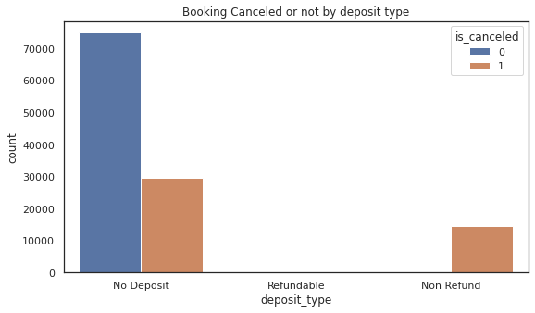
EDA (HOTEL BOOKING ANALYSIS) :
8. What Is The Relationship Between Deposit Type And Cancellation?

Slide 16
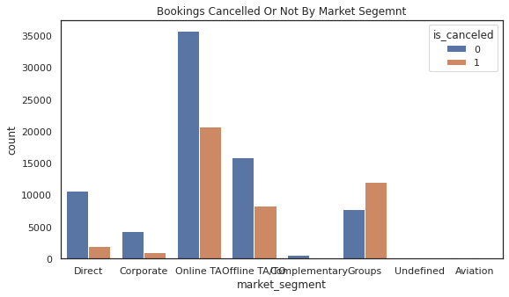
EDA (HOTEL BOOKING ANALYSIS) :
9. What Is The Relationship Between Market Segment And Cancellations?

Slide 17
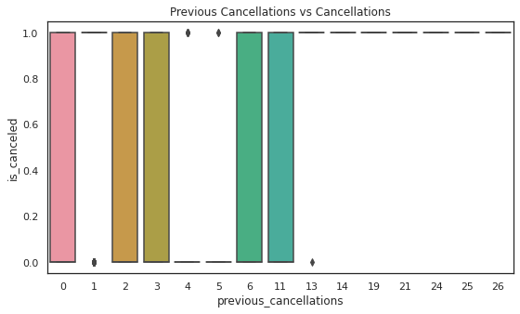
EDA (HOTEL BOOKING ANALYSIS) :
10. What Is The Relationship Between Previous Cancellations And Cancellation?

Slide 18
INFERENCES AND CONCLUSION :
Firstly, higher lead time has higher chance of cancellation. Also, history of previous cancellations increases chances of cancellation.
Secondly, The City hotel has more guests during spring and autumn, when the prices are also highest, In July and August there are less visitors, although prices are lower. Thus, customers can get good deal on bookings in July and August in city hotel.
Guest numbers for the Resort hotel go down slighty from June to September, which is also when the prices are highest. Thus, these months should be avoided for bookings.
Thirdly, Broadly, Arpil to August is the peak season of bookings. Both hotels have the fewest guests during the winter.
Fourthly, No deposit cancellations are high compared to other categories but these should not be discouraged per se as bookings in this category are also very high compared to non refundable type bookings.
Fifthly, cancellations are high when done through agents compared to direct bookings. Hotels need to do marketing and give special incentives for direct bookings as these may establish personal one to one relationships promoting customer loyalty.

Slide 19
Q & A

